Slide 1


Introduction to Fourier Transform Infrared Spectroscopy (FTIR)
FTIR measures infrared absorption and emission to identify chemical bonds.
This non-destructive technique is vital in materials science, chemistry, and pharmaceuticals.

Slide 2


Fundamentals and Principles of FTIR
Infrared absorption
Molecules absorb IR radiation at frequencies matching vibration modes.
Fourier Transform
Converts raw interferogram data into a readable spectrum.
Vibrational frequencies
Specific to molecular bonds, unique fingerprints for identification.

Slide 3
Uses and Applications of FTIR
Material Analysis
Polymer characterization
Chemical compound ID
Coating analysis
Pharmaceuticals & Food
Drug purity checks
Adulteration detection in foods
Environmental pollutant analysis

Slide 4




ample Requirements and Applicable Materials
Sample Forms
Solids, liquids, and gases can be analyzed.
Preparation Methods
KBr pellets, thin films, ATR technique.
Material Types
Polymers, organics, inorganics, coatings.
Limitations
Strong water absorption and particle size effects.

Slide 5
FTIR Data Acquisition and Results
Data Form
Peak Analysis
Preprocessing
Interferogram converted to Absorbance vs. Wavenumber spectrum.
Peaks correspond to molecular vibrations showing chemical groups.
Baseline correction and normalization improve accuracy.

Slide 6

Data Interpretation and Property Calculation
Identify Functional Groups
Peak positions reveal groups like C=O or N-H.
Quantify Concentrations
Peak intensity proportional to compound amount.
Advanced Analysis
Deconvolution resolves overlapping peaks for clarity.
Calculations
Crystallinity index from peak ratios in polymers.

Slide 7
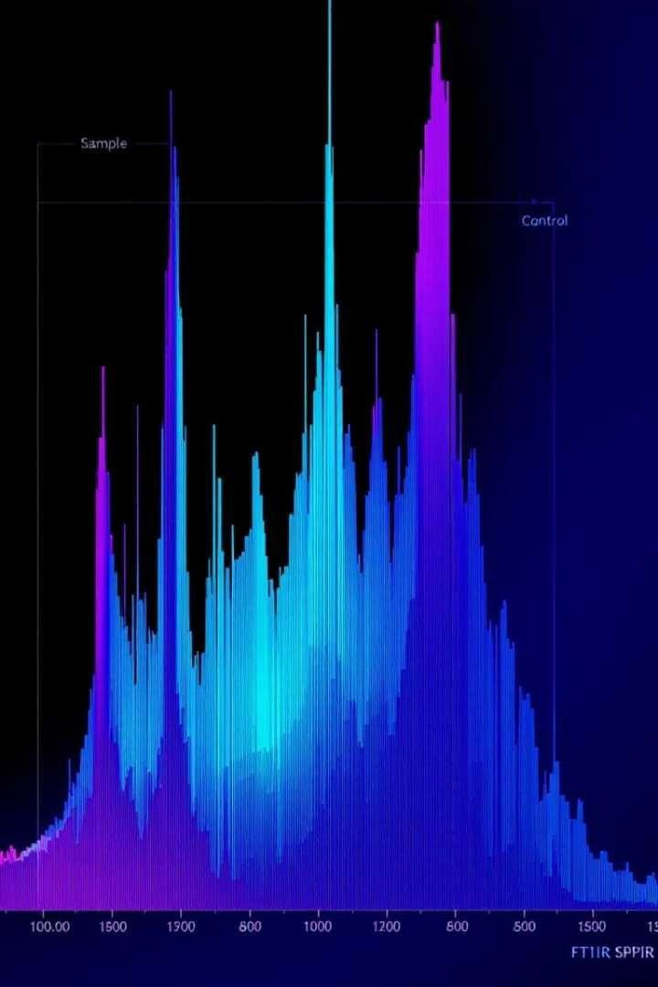

Research Example: Polymer Blend
1 2
Study Insight
Peak shifts indicate polymer miscibility.
Calculations
Blending degree estimated using peak area ratios.
3 Conclusion
FTIR confirms molecular interactions in blends.

Slide 8





Summary and Conclusion
Powerful Tool
Essential for diverse material characterization.
Expansive Applications
Used in polymers, pharmaceuticals, environment, and food.
Data Interpretation
Advancements
Ongoing improvements enhance accuracy and sensitivity.
Requires understanding of vibrational spectra and calculations.

